Slide 1
Chapter 5
Computer
Organization

Slide 2
OBJECTIVES
After reading this chapter, the reader should
be able to:
Distinguish between the three components of a computer hardware.
List the functionality of each component.
Understand memory addressing and calculate the number of bytes for a specified purpose.
Distinguish between different types of memories.
Understand how each input/output device works.
Continued on the next slide

Slide 3
OBJECTIVES (continued)
Understand the systems used to connect different
components together.
Understand the addressing system for input/output
devices.
Understand the program execution and machine cycles.
Distinguish between programmed I/O, interrupt-driven I/O and direct memory access (DMA).
Understand the two major architectures used to define
the instruction sets of a computer: CISC and RISC.

Slide 4
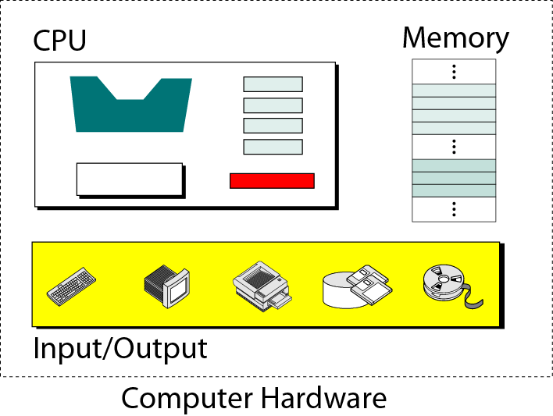
Figure 5-1
Computer hardware (subsystems)

Slide 5
5.1
CENTRAL
PROCESSING
UNIT
(CPU)

Slide 6
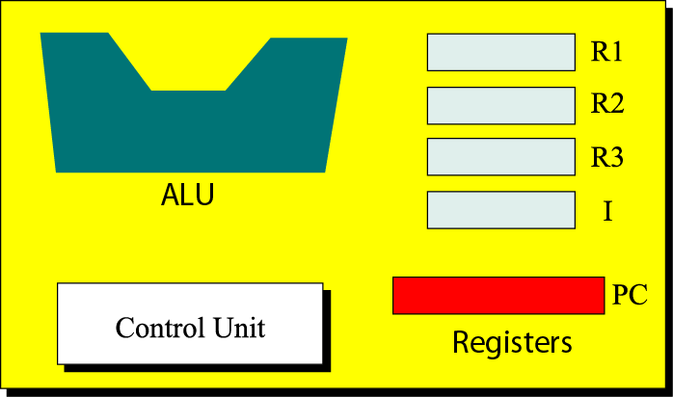
Figure 5-2
CPU

Slide 7
Central Processing Unit
--Arithmetic logic unit
Performs arithmetic and logical operations
Arithmetic operation
  Unary: increment (+1) and decrement (-1)
  Binary: add, subtract, multiply, and divide
Logical operation
  Unary: NOT
  Binary: AND, OR, XOR

Slide 8
Central Processing Unit
--Registers (暫存器)
Registers are fast storage locations that hold data temporarily.
Data registers
  Input data and output data
Instruction registers
Program counter

Slide 9
Central Processing Unit
--Control unit
The control unit is like the part of the human brain that controls the operation of each part of the body.
Controlling is achieved through wires (金屬線) that can be on (hot) or off (cold).

Slide 10
5.2
MAIN MEMORY

Slide 11
Main Memory
Unit
------------
kilobyte
megabyte
gigabyte
terabyte
petabyte
exabyte
Exact Number of bytes
------------------------
2¹⁰ bytes
2²⁰ bytes
2³⁰ bytes
2⁴⁰ bytes
2⁵⁰ bytes
2⁶⁰ bytes
Approximation
------------
10³ bytes
10⁶ bytes
10⁹ bytes
10¹² bytes
10¹⁵ bytes
10¹⁸ bytes
Table 5.1 Memory units

Slide 12
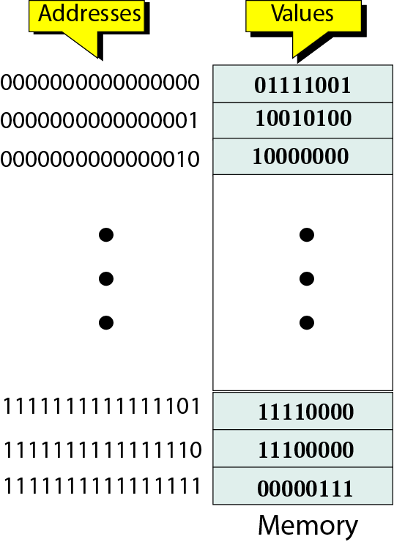
Figure 5-3
Main memory
Address space:
  the total number of uniquely identifiable locations in memory

Slide 13

Address as bit pattern
Note:
Memory addresses are defined using
unsigned binary integers.

Slide 14
Example 1
A computer has 32 MB (megabytes) of memory. How many bits are needed to address any single byte in memory?
Solution
The memory address space is 32 MB, or 2²⁵ (2⁵ x 2²⁰). This means you need log₂ 2²⁵ or 25 bits, to address each byte.

Slide 15
Example 2
A computer has 128 MB of memory. Each word in this computer is 8 bytes. How many bits are needed to address any single word in memory?
Solution
The memory address space is 128 MB, which means 2²⁷. However, each word is 8 (2³) bytes, which means that you have 2²⁴ words. This means you need log₂ 2²⁴ or 24 bits, to address each word.

Slide 16
Memory types-- RAM
RAM: random access memory
  SRAM: static RAM
    flip-flop gats (正反器)
    No need to be refreshed
    Catch memory
  DRAM: dynamic RAM
    capacitors (電容)
    Need to be refreshed periodically
    Main memory

Slide 17
Memory types– ROM
ROM: read-only memory
  PROM: programmable ROM
    Only written once
  EPROM: erasable PROM
    Use ultraviolet light (紫外光) to erase data
  EEPROM: electronically EPROM
    Can be erased using electronic impulses

Slide 18
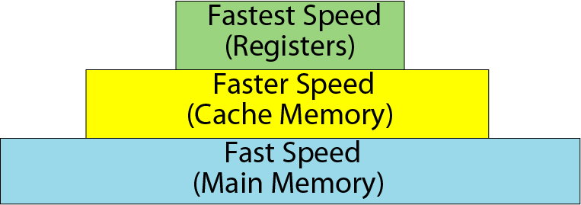
Figure 5-4
Memory hierarchy

Slide 19
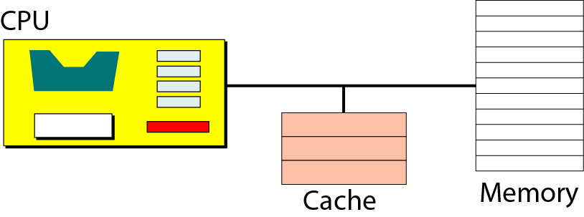
Figure 5-5
Cache memory

Slide 20
Catch memory
Why is catch memory so efficient despite its small size?
  The answer is 80-20 rule.
  Most computers spend 80 percent of the time accessing only 20 percent of the data.

Slide 21
5.3
INPUT / OUTPUT

Slide 22
Input/Output devices
Nonstorage devices
  Keyboard and monitor
  Printer
Storage devices
  Magnetic (磁性的) storage devices
  Optical (光學的) storage devices

Slide 23
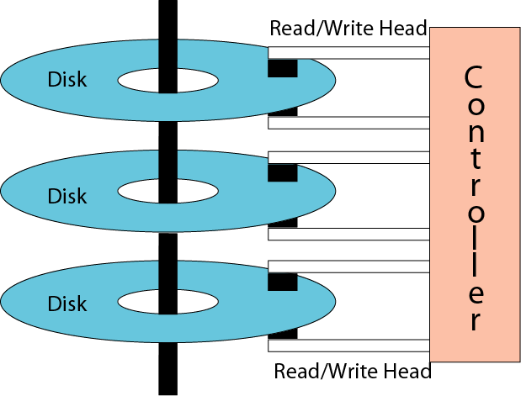
Figure 5-6
Physical layout of a magnetic disk

Slide 24
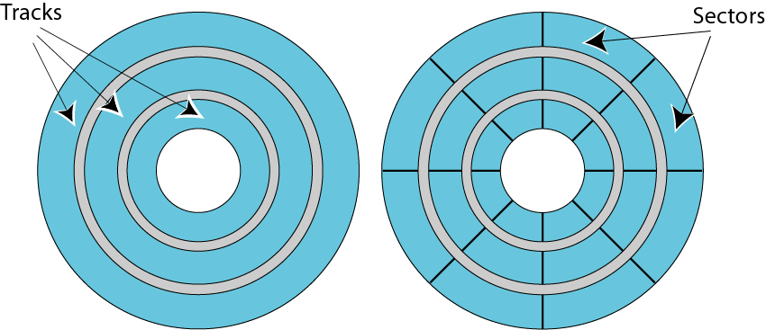
Figure 5-7
Surface organization of a disk
Intertrack
gap
Intersector
gap

Slide 25
Magnetic Disk
Surface organization
  Tracks and sectors
Data access
  Random access, one sector a time
Performance
  Rotational speed, seek time, and transfer time

Slide 26
Definitions
Rotational speed
  How fast the disk is spinning (旋轉)
Seek time
  The time to move the read/write head to the desired track
Transfer time
  The time to move data from the disk to the CPU/memory

Slide 27
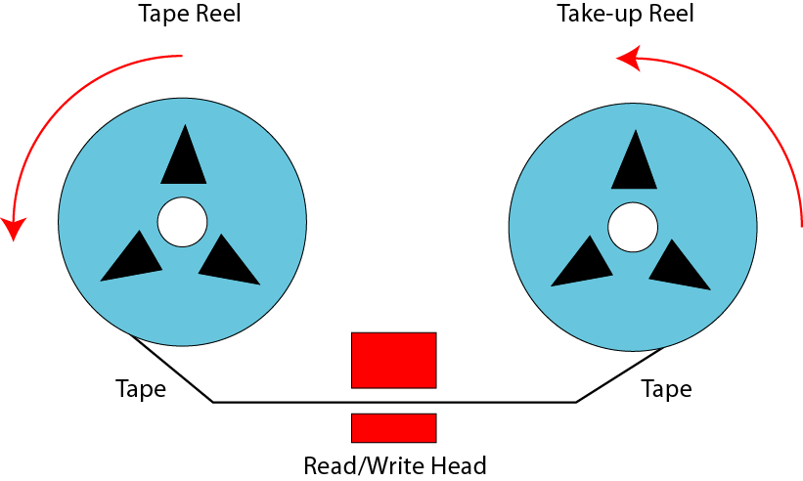
Figure 5-8
Mechanical configuration of a tape

Slide 28
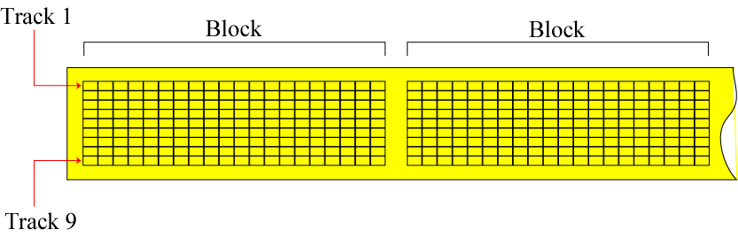
Figure 5-9
Surface organization of a tape

Slide 29
Magnetic Tape
Surface organization
  Nine tracks (8 bits for information and 1 bit for error detection)
Data access
  Sequential access
Performance
  Slower than a magnetic disk

Slide 30
Optical storage devices
CD-ROM: compact disc (薄圓片) ROM
  Capacity: 650MB
CD-R: compact disc recordable
CD-RW: compact disc rewritable
DVD: digital versatile (多種的)disc
  Capacity: 4.7GB – 17GB

Slide 31
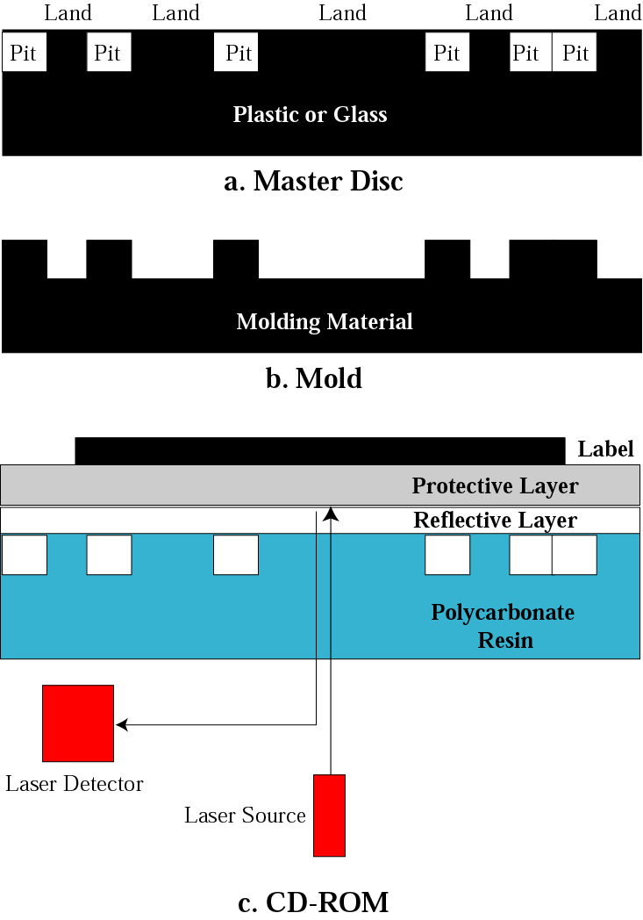
Figure 5-10
Creation and use of CD-ROM

Slide 32
CD-ROM--Creation
The steps to create a CD (650MB)
  Create a master disc
    Using a high-power infrared (紅外線) laser
    Pits (holes, 0) and lands (no holes, 1)
  Make a mold (模子)
  Create a CD
    Injected (注入) molten (溶解的) polycarbonate resin (樹脂) into the mold
    Add a reflective layer (aluminum鋁) and a protective layer (lacquer漆)

Slide 33
CD-ROM--Reading
Using low-power laser beam (光束) to read
  The laser beam is reflected by the aluminum surface when passing through a land.
  It is reflected twice when it encounters a pit, once by the pit boundary and once by the aluminum boundary.
  more light → land, less light → pit

Slide 34
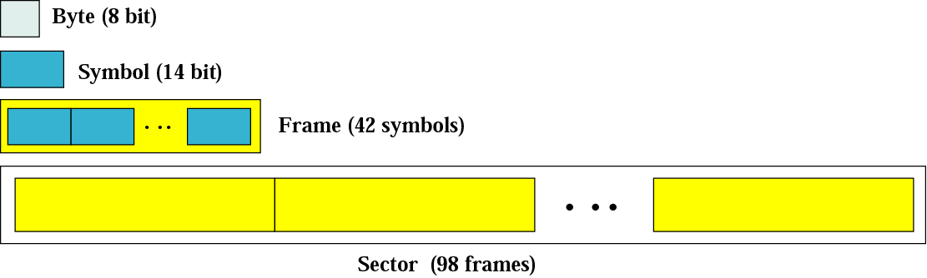
Figure 5-11
CD-ROM format
Using hamming code
  8-bit for data transformed into a 14-bit symbol using an error correction method
A frame is made of 42 symbols
A sector is mode of 96 frames

Slide 35
CD-ROM-- speed
Speed
------------
1x
2x
4x
6x
8x
12x
16x
24x
32x
40x
Data Rate
------------------------
153,600 bytes per second
307,200 bytes per second
614,400 bytes per second
921,600 bytes per second
1,228,800 bytes per second
1,843,200 bytes per second
2,457,600 bytes per second
3,688,400 bytes per second 4,915,200 bytes per second
6,144,000 bytes per second
Approximation
------------
150 KB/s
300 KB/s
600 KB/s
900 KB/s
1.2 MB/s
1.8 MB/s
2.4 MB/s
3.6 MB/s
4.8 MB/s
6 MB/s
Table 5.2 CD-ROM speeds

Slide 36
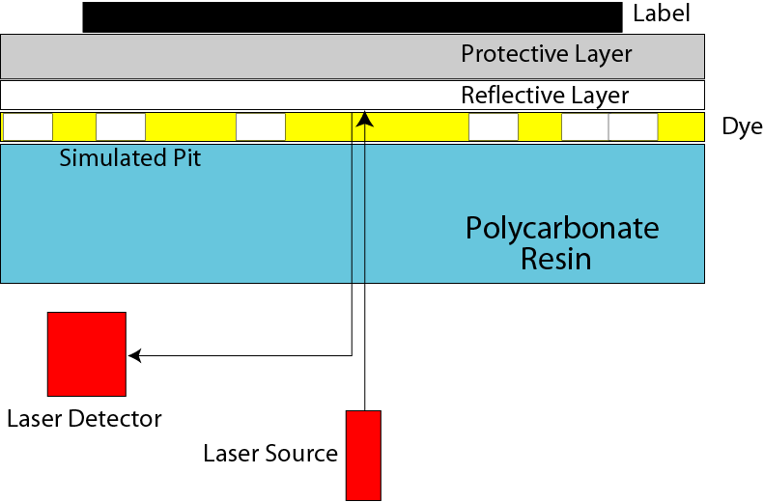
Figure 5-12
Making a CD-R

Slide 37
CD-R
Write once, read many (WORM)
Creation
  No master disc or mold
  Reflective layer → gold
  No physical pits → simulated pits
  Using a high-power laser beam
    Dark spot in the dye (染料) to simulate a pit

Slide 38
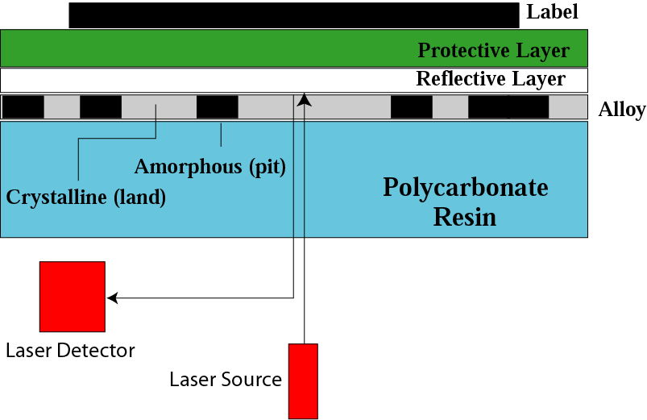
Figure 5-13
Making a CD-RW

Slide 39
CD-RW
Creation
  Instead of dye → uses an alloy (合金) of silver(銀), indium(銦), antimony (銻), and tellurium(碲).
  Two states
    Amorphous (非結晶質): pit
    Crystalline (結晶質(可穿透)): land
  Using high-power laser to create

Slide 40
DVD
Differences between DVD and CD-ROM
  DVD: The pits are smaller
  DVD: The tracker are closer
  DVD: The beam is red laser
  DVD: uses one to two recording layers
    Single-sided or double-sided

Slide 41
Table 5.3 DVD capacities
Feature
---------------------------------
single-sided, single-layer
single-sided, dual-layer
double-sided, single-layer
double-sided, dual-layer
Capacity
------------
4.7 GB
8.5 GB
9.4 GB
17 GB
DVD uses MPEG for compression
A single-sided single-layer DVD
  133 minutes of video at high resolution

Slide 42
5.4
SUBSYSTEM
INTERCONNECTION

Slide 43
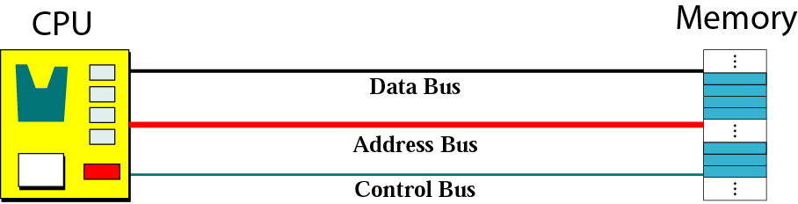
Figure 5-14
Connecting CPU and memory using three buses

Slide 44
Buses
Data bus:
  The number of wires depends on the size of the word
Address bus:
  The number of wires depends on the address space of memory
Control bus:
  The number of wires depends on the total number of control commands a computer needs

Slide 45
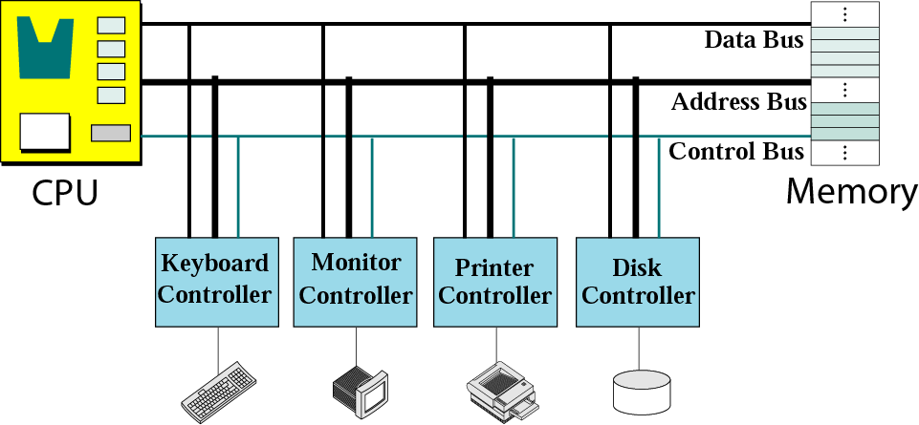
Figure 5-15
Connecting I/O devices to the buses

Slide 46
Controllers
A controller can be a serial or parallel device.
  SCSI: small computer system interface
    Parallel interface
  FireWire: IEEE standard
    A high-speed serial interface (50MB/sec)
  USB: universal serial bys
    A serial controller (1.5 MB/sec – 500MB/sec (USB2.0))

Slide 47
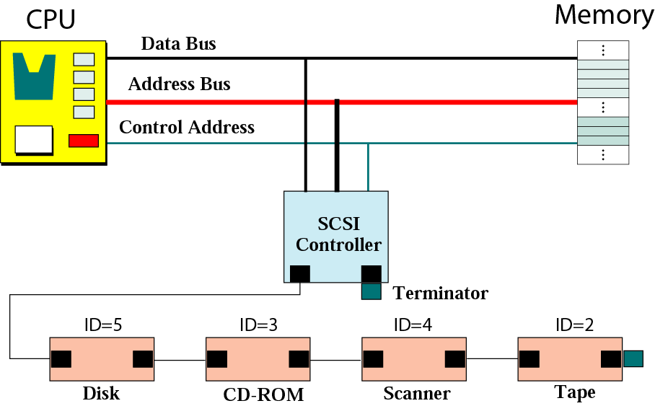
Figure 5-16
SCSI controller (a chain)

Slide 48
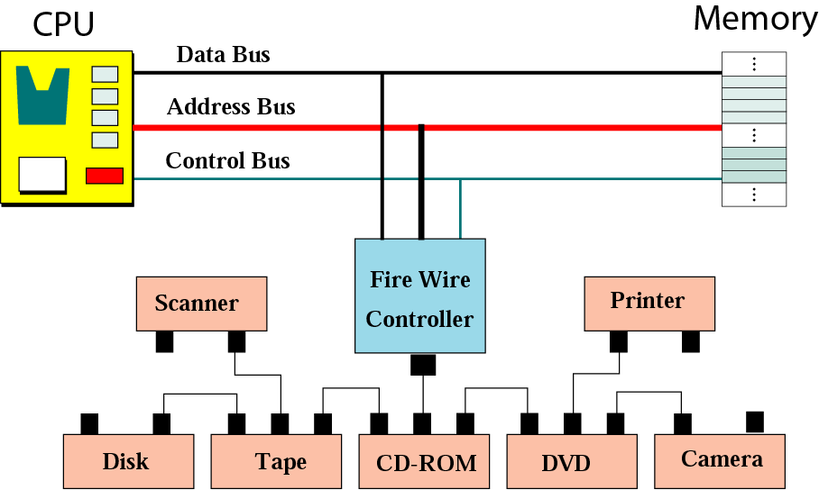
Figure 5-17
FireWire controller (tree)

Slide 49
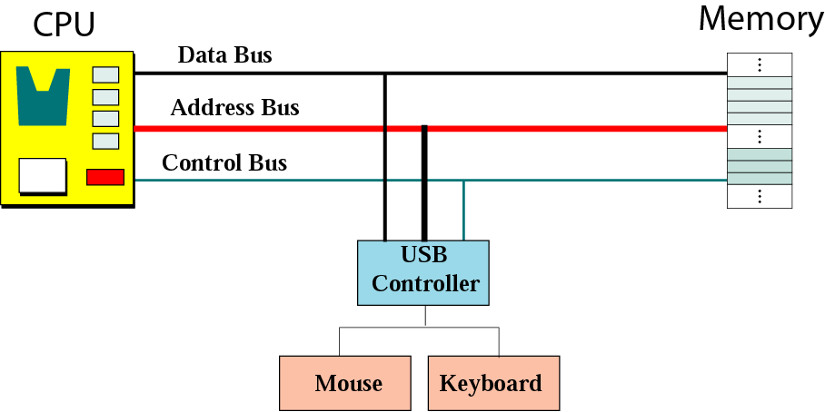
Figure 5-18
USB controller

Slide 50
Addressing I/O devices
Isolated I/O
  Each input/output device has its own address.
Memory-mapped I/O
  CPU treats each register in the input/output controller as a word in memory

Slide 51
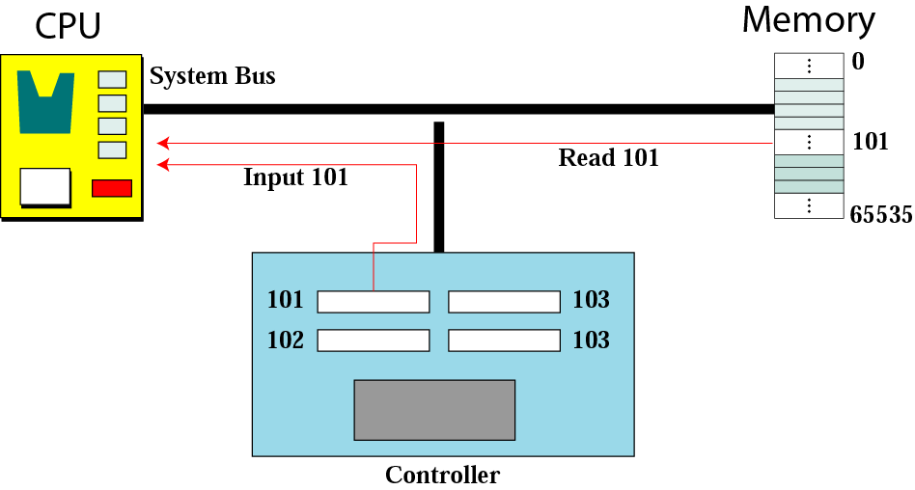
Figure 5-19
Isolated I/O addressing

Slide 52
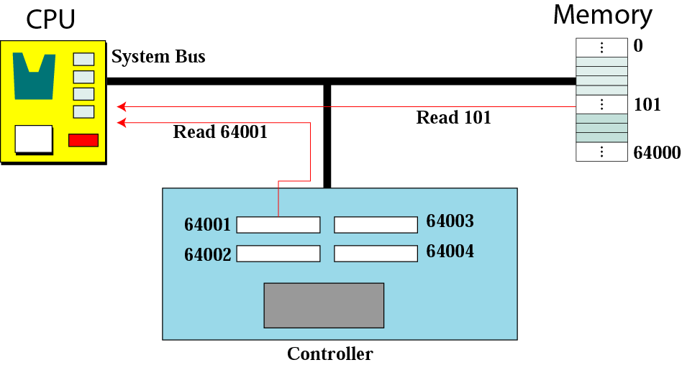
Figure 5-20
Memory-mapped I/O addressing

Slide 53
5.5
PROGRAM
EXECUTION

Slide 54
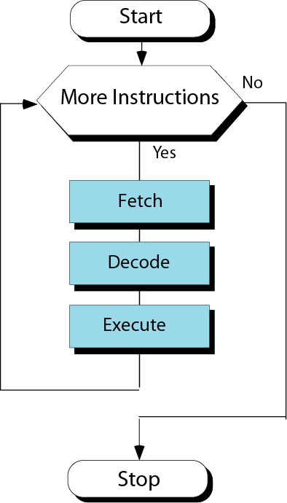
Figure 5-21
Steps of a cycle

Slide 55
Machine cycle
Fetch:
  To copy the next instruction into the instruction register in the CPU
Decode
  Decode the instruction
Execute
  Execute the instruction

Slide 56
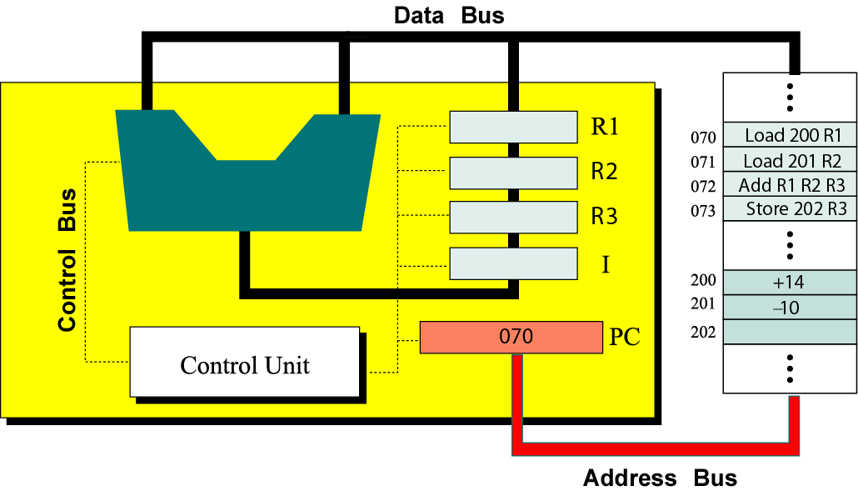
An example
Figure 5-22
Contents of memory and register before execution

Slide 57
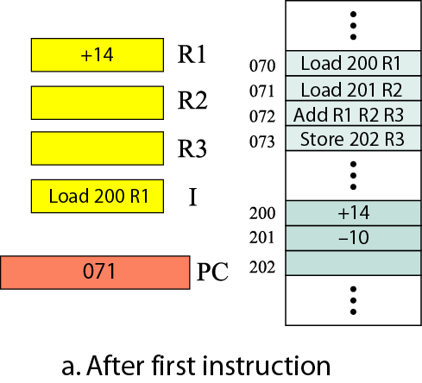
Figure 5-23.a
Contents of memory and
registers after each cycle

Slide 58
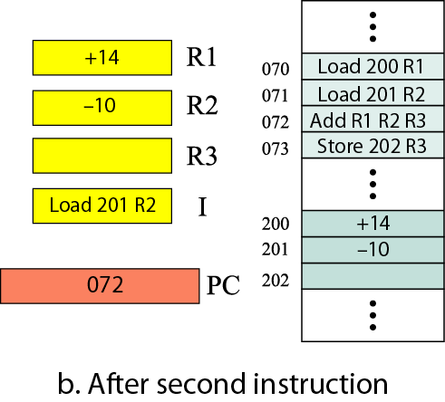
Figure 5-23.b
Contents of memory and
registers after each cycle

Slide 59
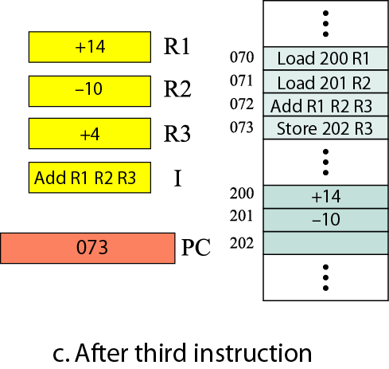
Figure 5-23.c
Contents of memory and
registers after each cycle

Slide 60
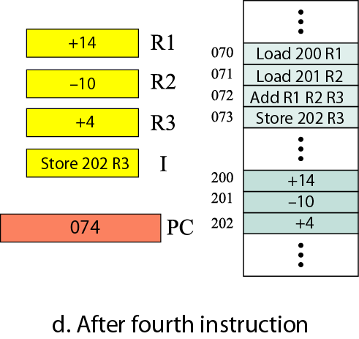
Figure 5-23.d
Contents of memory and registers after each cycle

Slide 61
Input/Output operation
Programmed I/O
  CPU waits for the I/O device
Interrupt-driven I/O
  The device interrupts the CPU when it is ready
Direct memory access (DMA)
  Use to transfer a large block of data
  CPU is idle for only a short time

Slide 62
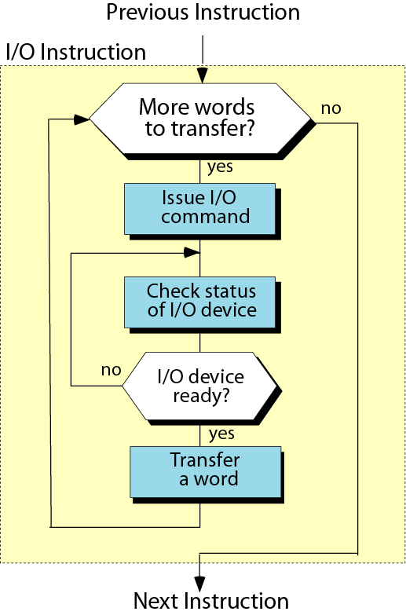
Figure 5-24
Programmed I/O

Slide 63
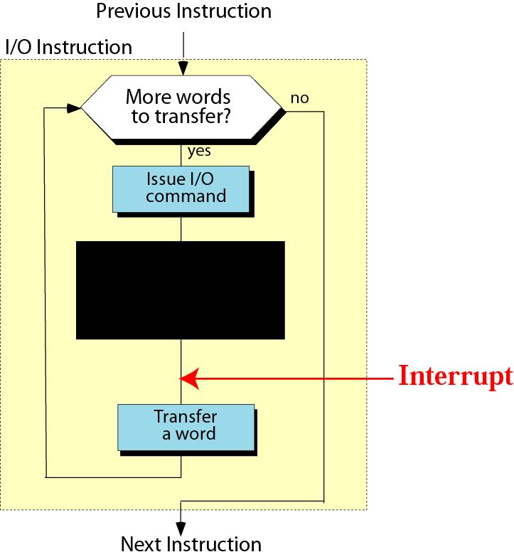
Figure 5-25
Interrupt-driven I/O

Slide 64
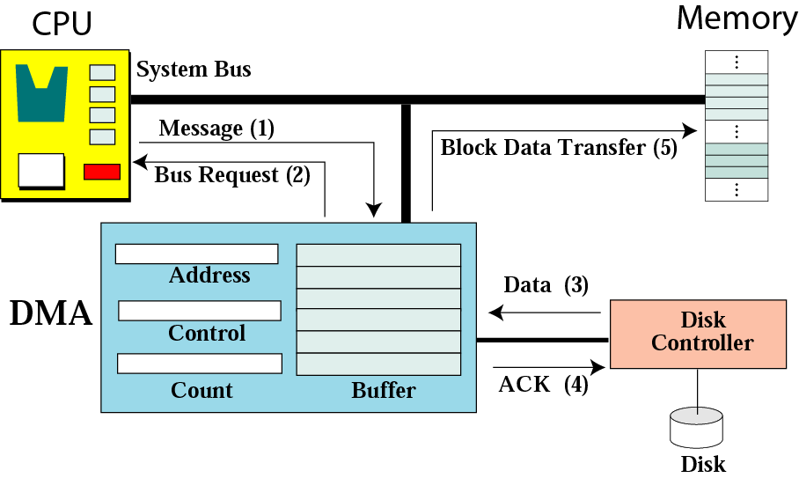
Figure 5-26
DMA connection to the general bus

Slide 65
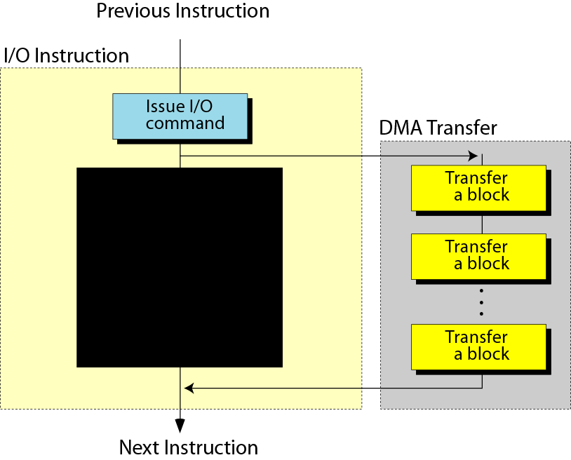
Figure 5-27
DMA input/output

Slide 66
5.6
TWO DIFFERENT
ARCHITECTURES

Slide 67
Architectures
CISC: complex instruction set computer
  Have a large set of instructions, including the complex ones
  Micro-operation, micro-memory, micro-programming (p. 92)
  i.e. Intel Pentium
RISC: reduced instruction set computer
  Have a small set of instructions that do a minimum number of simple operations
  i.e. Apple PowerPC

Slide 68
Key terms
Address bus
Address space
Arithmetic logic unit (ALU)
Arithmetic operation
Bit pattern
Bus
Cache memory
Central processing unit (CPU)
CD-ROM
CD-R
CD-RW
CISC
Control bus
Control unit
Data bus
Data register
DVD
Direct memory access
DRAM
EEPROM
EPROM
Execute
Fetch
FireWire
Frame
I/O controller
I/O subsystem
Instruction register
Interrupt-driven I/O

Slide 69
Isolated I/O
Keyboard
Land
Logical operation
Machine cycle
Magnetic disk
Magnetic tape
Main memory
Memory-mapped I/O
Monitor
Nonstorage device
Optical storage device
Pit
Printer
Program counter
PROM
Programmed I/O
Random access memory (RAM)
Read-only memory (ROM)
Read/write head
RISC
Register
Rotational speed
Sector
Seek time
SCSI
Static RAM (SRAM)
Storage device
Track
Transfer time
USB
Write once, read only (WORM)

